Slide 1
Reverse Engineering
Dr. Tyler Bletsch and Jiaming Li
Includes material adapted from "Computer Science 654 Lecture 5: Software Reverse Engineering" by Wayne Patterson, Howard Univ. 2009.

Slide 2
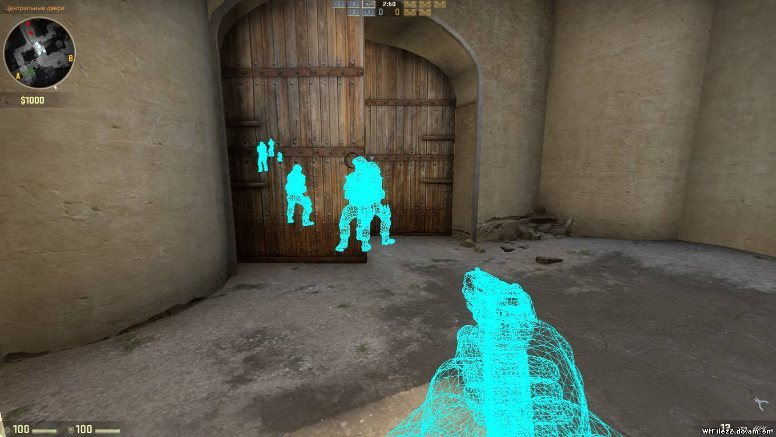
What is software reverse engineering?
Determine and possibly change program logic
“Logic” ≠ Just observed behavior
Ethics
Useful for good:
Analyze malware
Understand undocumented legacy code
Watch/read/play the damn crap you paid for
Useful for evil
“Crack” software (remove restrictions)
Find exploits
Cheat at games

Slide 3
Types of tools
Disassembler
Turn compiled program into assembly
Not perfect
Static tool
Debugger
Step through running program
Dynamic tool
Hex editor
Make changes to binaries
Monitoring tools
Watch system calls, library calls, etc.
Also, decompiler:
Attempts to turn assembly back into source code.
Usually awful at machine code, but managed code (e.g. Java, Python) can produce decent results.

Slide 4
Examples of tools
Linux:
Disassember: objdump (free), IDA Pro (free and paid versions)
Debugger: gdb and its front-ends
Hex editor: okteta, bless, lots more…
Monitoring: strace, ltrace
Windows:
Disassembler: IDA Pro (free and paid versions)
Debugger: WinDBG (basic), OllyDbg (shareware), SoftICE ($1000+)
Hex editor: XVI32, Notepad++ with plugin, etc.
Monitoring tools: Process Monitor, Explorer, and more.
X86 in general: A hypervisor (VMware, KVM, etc.)
IDA Pro eats basically anything

Slide 5
Debug or disassemble? Both.
Disassembler gives static results
Good overview of program logic
But need to “mentally execute” program
Difficult to jump to specific place in the code
Debugger is dynamic
Can set break points
Can treat complex code as “black box”
Not all code disassembles correctly
Disassembler and debugger both required for any serious SRE task
From "Computer Science 654 Lecture 5: Software Reverse Engineering" by Wayne Patterson, Howard Univ. 2009.

Slide 6
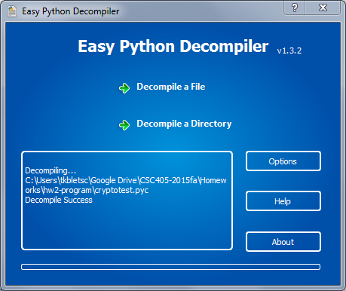
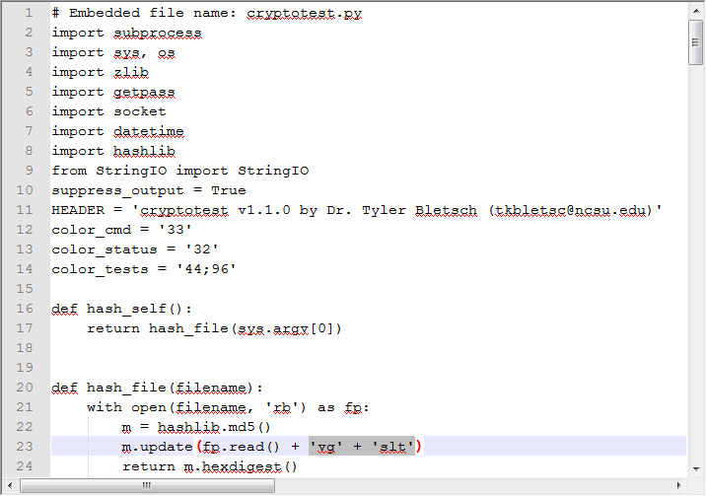
Example 1: HW2 auto-grader
Python decompiles very easily

Slide 7
Example 2: Minecraft
Minecraft is a Java program, no mod support
All mods use something like the Mod Coder Pack (MCP):
“Use MCP to decompile the Minecraft client and server jar files.
Use the decompiled source code to create mods for Minecraft.
Recompile modified versions of Minecraft.
Reobfuscate the classes of your mod for Minecraft.”
Entire mod community is built on reverse engineering!

Slide 8
Examining multi-component systems
Weaknesses often at the seams – where parts of system come together
Most visible, often exploitable
Example: SQL injection
If not the seams, at least focus on the least protected part

Slide 9
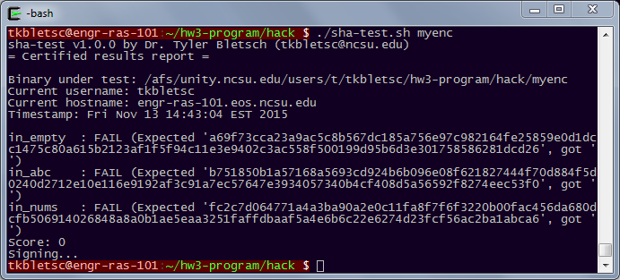
Example 3: HW3 auto-grader
Files:
Binary: hw3sign
Shell script: sha-test.sh
Normal usage:

Slide 10
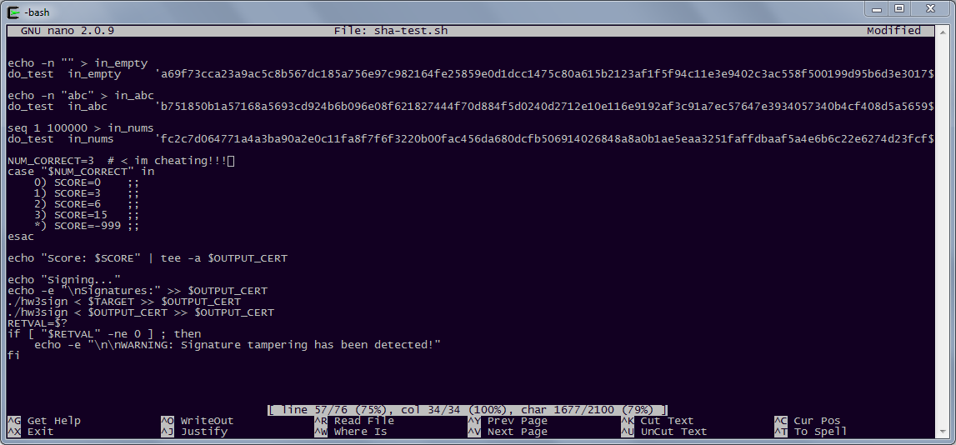
Example 3: HW3 auto-grader
Naïve attack: Just change the script

Slide 11
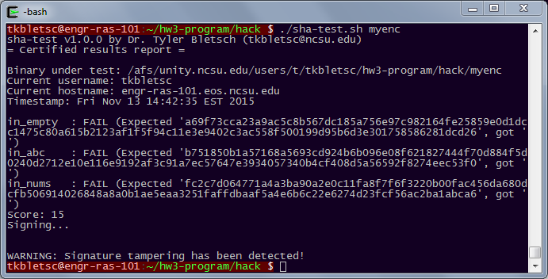
Example 3: HW3 auto-grader
Naïve attack: Just change the script
Failed: hw3sign must be checking it somehow.

Slide 12
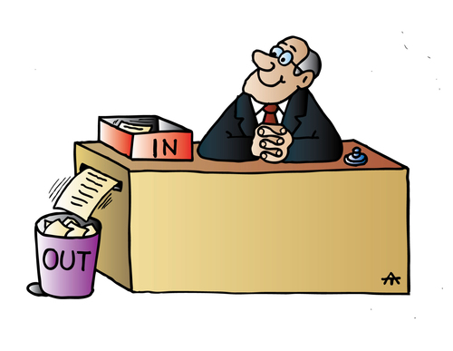
Example 3: HW3 auto-grader Topology
hw3sign
sha-test.sh

Slide 13
Example 3: HW3 auto-grader
Could look at behavior with strace:
$ strace -f -o trace.txt ./sha-test.sh myenc ...
$ cat trace.txt
4127 execve("./sha-test.sh", ["./sha-test.sh", "myenc"], [/* 46 vars */]) = 0
4127 brk(0) = 0x1700000
4127 mmap(NULL, 4096, PROT_READ|PROT_WRITE, MAP_PRIVATE|MAP_ANONYMOUS, -1, 0) = 0x7f55d5a17000
4127 access("/etc/ld.so.preload", R_OK) = -1 ENOENT (No such file or directory)
4127 open("/etc/ld.so.cache", O_RDONLY) = 3
4127 fstat(3, {st_mode=S_IFREG|0644, st_size=210058, ...}) = 0
4127 mmap(NULL, 210058, PROT_READ, MAP_PRIVATE, 3, 0) = 0x7f55d59e3000
close(3) = 0
...
But hw3sign never appears to open sha-test.sh:
$ grep open trace.txt | grep sha-test.sh
4127 open("./sha-test.sh", O_RDONLY) = 3
This one line is from when sha-test.sh itself is started
There’s more mystery here that I’ll leave to you…

Slide 14
Example 3: HW3 auto-grader Best place to attack?
hw3sign
sha-test.sh

Slide 15
Example 3: HW3 auto-grader
Two successful student attacks
Black box attack:
hw3sign signs the binary, then the certificate itself
What if we ask it to “test” a doctored certificate as a binary – it will sign it for us! No understanding needed!
Chameleon attack:
Add cheating to sha-test.sh; also add code to copy a legit sha-test.sh over itself before doing signings
Malicious behavior occurs then hides before check occurs

Slide 16
Example 4: NSA Codebreaker challenge
Scenario:
Terrorists using a cryptography program to decrypt/authenticate messages from leadership
What we have:
The program: codebreaker3.exe
A member’s key: tier1_key.pem
A text file with a hidden message: tier1_msg.txt
At first glance, the program appears to simply check stock information, but that’s a ruse.
Need to reverse engineer it: Challenge has 4 tasks, we’ll do 2.

Slide 17
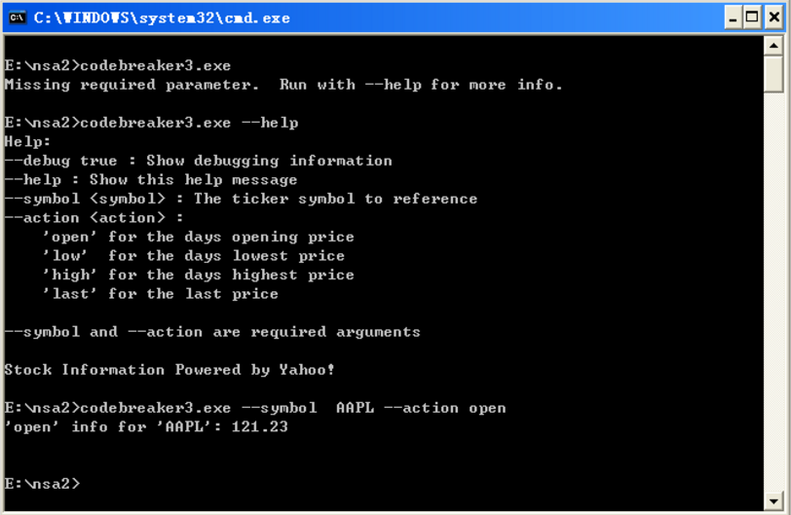
Codebreaker Task 1: Decrypt
Need to decode message we have.
The program:

Slide 18
Codebreaker Task 1: Decrypt
Do static analysis with IDA Pro
Load binary
Confirm binary format options
Process:
Code is disassembled
Call graph of assembly code built
All memory references are cross-referenced, especially string literals

Slide 19
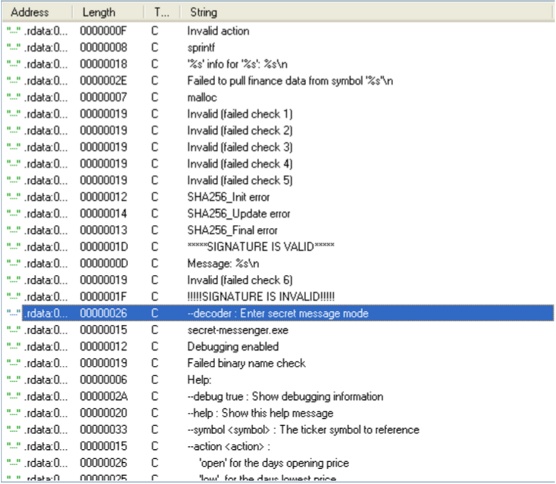
Codebreaker Task 1: Decrypt
Do static analysis with IDA Pro, check the all string information

Slide 20
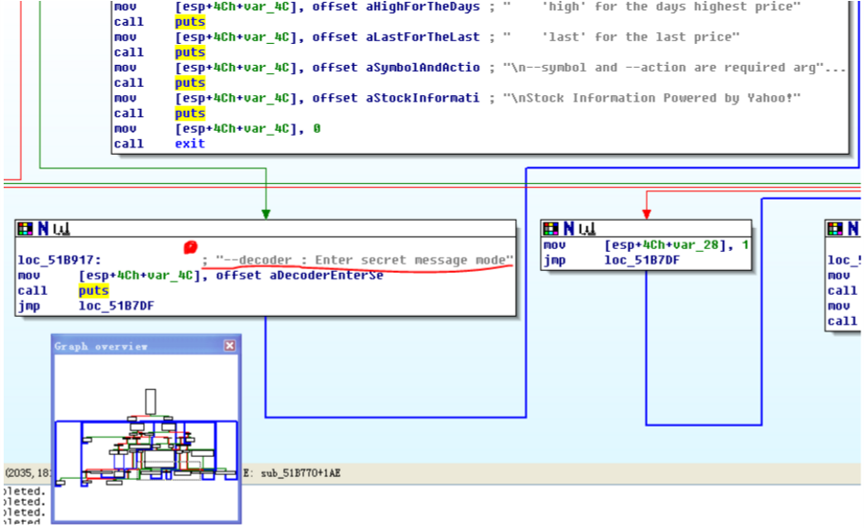
Codebreaker Task 1: Decrypt
Press x, this leads us to the location where this string appears:

Slide 21
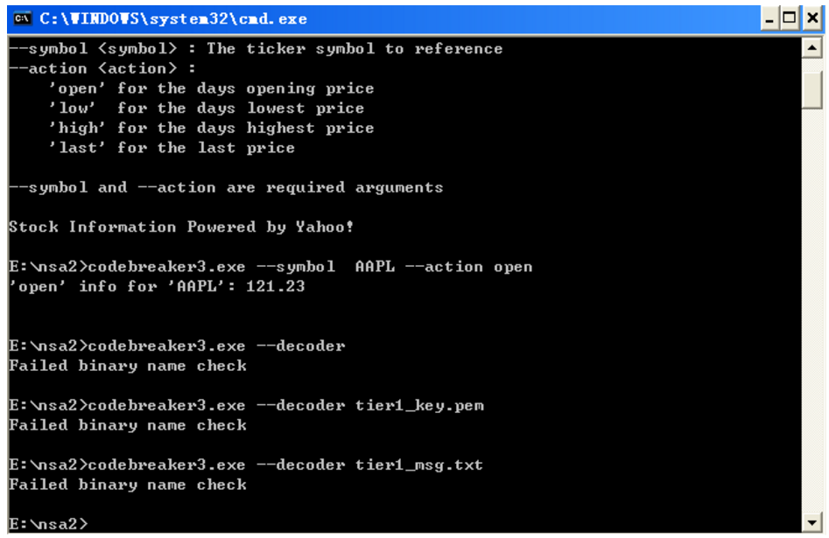
Codebreaker Task 1: Decrypt
OK, let’s try “decoder” parameter:

Slide 22
Codebreaker Task 1: Decrypt
We need to find where “Failed binary name check” appears:
and this comes from:

Slide 23
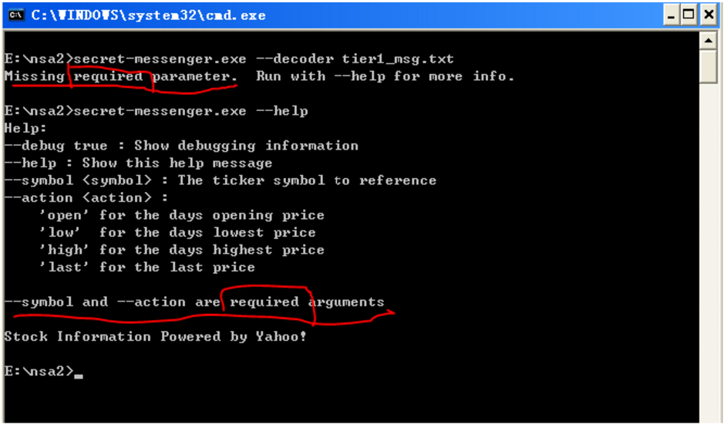
Codebreaker Task 1: Decrypt
Then we change our program name to “secret-messenger.exe” and try again:

Slide 24
Codebreaker Codebreaker Task 1: Decrypt
Ideas?
Let’s jam the stuff into symbol and action fields

Slide 25
Codebreaker Task 2: Bypass access limitation
We’ve collected a new message file - this one to a different field operative whose key we also have.
Each operative has their own decrypt tool, each tool will only decrypt content “addressed” to a its owner.
Need to defeat this access limitation to decrypt the message.

Slide 26
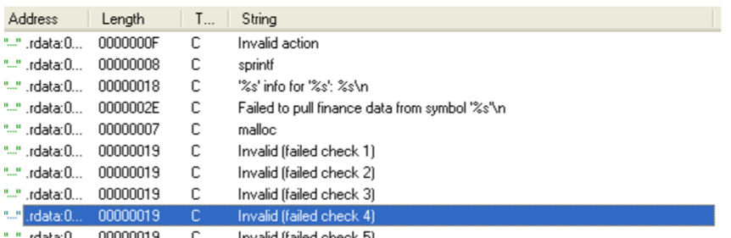
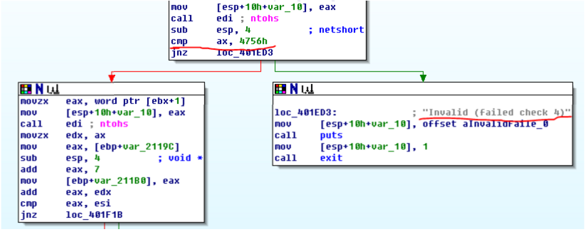
Codebreaker Task 2: Bypass access limitation
Let’s go back to IDA to find where this error appears:

Slide 27
Codebreaker Task 2: Bypass access limitation
Note down the address of “cmp ax,4756h”, press SPACE:
How to test if this is the check?
How to bypass the check?

Slide 28
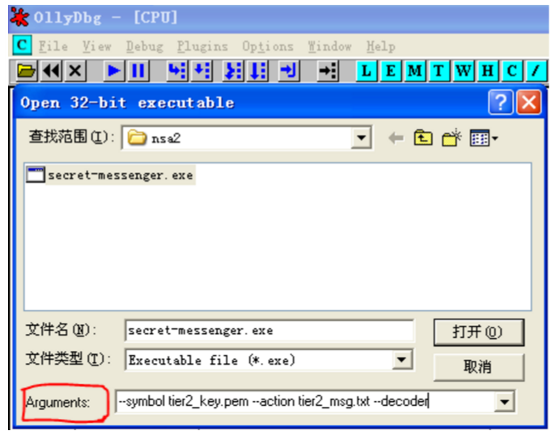
Codebreaker Task 2: Bypass access limitation
In order to bypass this check as easily as possible, we can just modify the assembly code or change the specific flag during execution. Load the program with ollydbg:

Slide 29
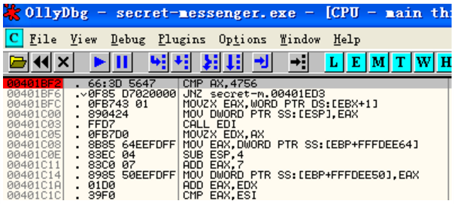
Codebreaker Task 2: Bypass access limitation
Press CTRL+g go to the address 00401bf2, press F2 set breakpoint:

Slide 30
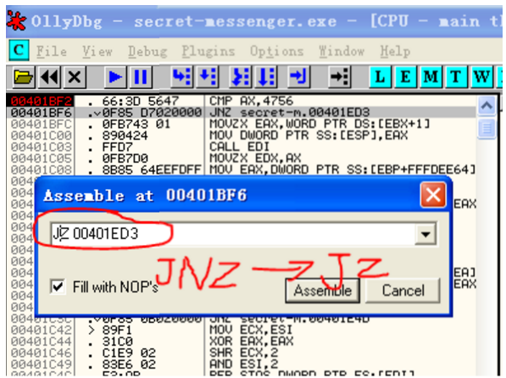
Codebreaker Task 2: Bypass access limitation
Let’s run the program and it will stop at this breakpoint, press F8 to run one more step and we modify the conditional JUMP instruction manually:

Slide 31
Codebreaker Task 2: Bypass access limitation
Then, right click → copy to executable→ all modification, so we just saved our new program, let’s try to run it:

Slide 32
Codebreaker Tasks 3 and 4
Task 3: Analyze decryption logic and develop a compatible encryption tool
Task 4: Spoof messages so they appear to come from group leadership. Tell all recipients: “Leadership has arranged a meeting with the local authorities…Meet at the city police station at 18:00. Be discreet, and come unarmed as to not draw attention.” (LOL)

Slide 33
Anti-reverse engineering
Basics:
Turn off debug symbols (-g)
Strip other symbols (e.g. “strip” tool on *NIX)
Consider static linking (no external calls to standard libraries to trace)
Anti-disassembly:
Encrypted or self-modifying code
Code riddled with junk that is jumped over
Can especially confuse x86 assemblers due to variable-length instructions
Anti-debugging:
Identify if debugger is in use (effects on real time, use of debug registers, etc.) and act differently
Use threads in complex ways to get less deterministic behavior
Tamper resistance:
Hash parts of ones own code/data and verify periodically
The verification code is also code, though…
Obfuscation:
Include lots of unreachable code to increase work the reverse engineer must do

Slide 34
DRM: Digital Rights Management
Attempt to restrict what users can do with data they have on a computer they own
Almost every implementation looks like this:
Customer gets everything in the dashed box
Problem?

Slide 35
If asked to implement DRM

Slide 36
DRM deployment process
DRM scheme is deployed
DRM scheme is cracked in 5 minutes
Crackers/pirates have nice open product, paying customers get inferior locked product
Developer makes fat stacks of cash
Angry executives vow to make next generation of DRM even more draconian (but no less crackable), alienating paying customers and hastening their business model’s demise.
(LOL)
Lots of frantic meetings in some corporate office
Pirated variant goes on sale in gray market

